Slide 1


Wi-Fi Technology Fundamentals
Module-1
Introduction and History of WiFi
Session-1a
Wi-Fi Evolution

Slide 2

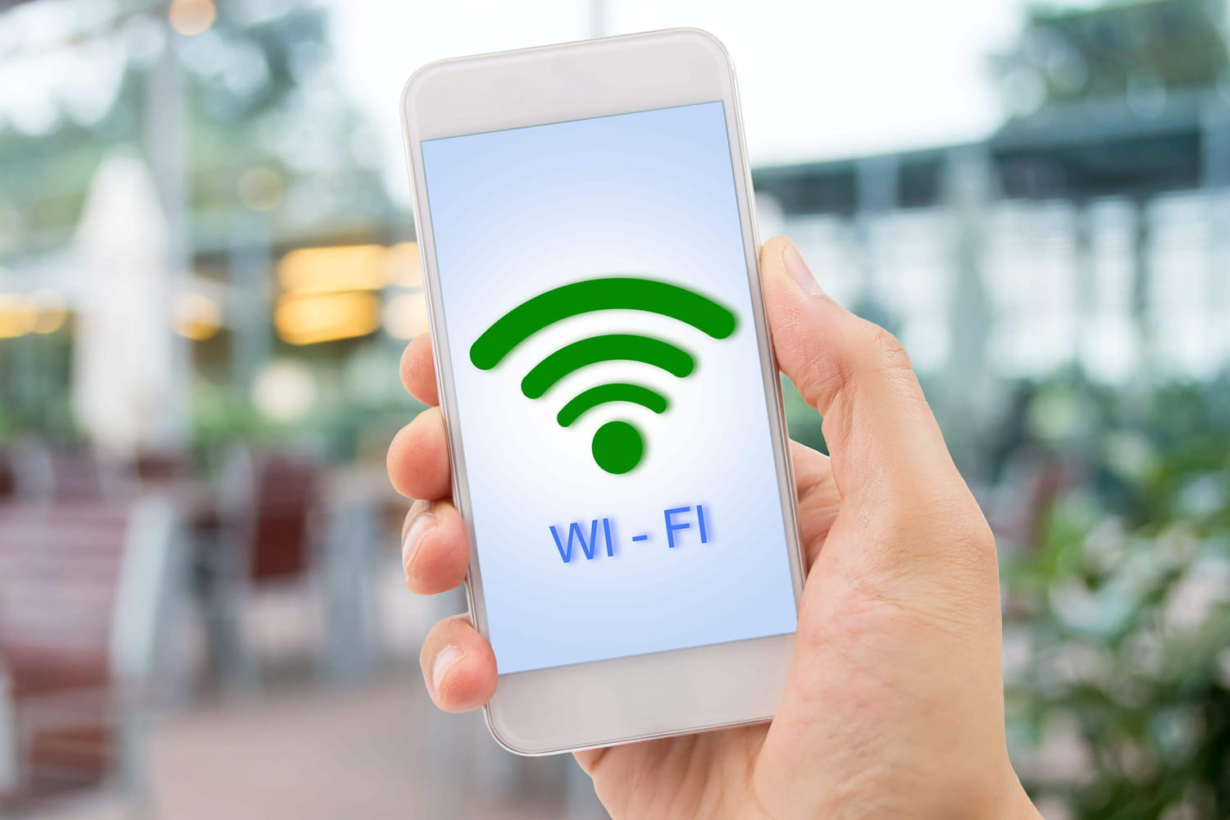
Pyramid of Basic Human Needs
Self- Realization
Self-esteem
Friends, Family
Safety, Security
Food, Water, Shelter
Wi-Fi

Slide 3

Course Objective
While most technology courses may take a bottoms up academic approach of explaining the subject matter with definitions and formulas, the attempt of this course would be to explain all the concepts in as simple and as practical way as possible by providing real work examples and industry applications and showing real demos and visualizations of the concepts where ever possible. Our goal with this course is to make the complex world of WiFi easy to understand for beginners and also hopefully generate more interest among young engineers and college students to build a successful career in this amazing and rapidly growing field of WiFi.
Who is this course for?
Junior/Mid-Level engineers working in any form of technical roles in the WiFi Industry
Bachelors/Masters Degree students pursing a career in the computer networking / wireless networking industry
Academicians interested in developing industry focused course work.
Pre-requisites
Basics of Computer Networking, Any prior academic courses or certifications like CCNA
Nice to have basic understanding of wireless communications, Digital Communications.
Nice to have some prior academic knowledge of WiFi standards and protocols or have some industry experience and a WiFi developer of test engineer.

Slide 4
What Does each Session Cover
Basic theoretical concepts of each topic.
Real-world / Industry applications of the topic.
Practical Demos of the concepts of each topic using any tools available.
A short fun quiz at the end of each session.
Each session is expected to be 45min-60mins of duration.
Course Fees and Copyright Policy
This course is completely free for anyone attending. The material can also be downloaded and can be used for free.
Several images in the presentations will be copied from the internet and books and credit will be given to the source of the information wherever possible.
The presenter does not intend to use this material for any commercial purposes.
Course Delivery
The course is entirely delivered online over web conferencing sessions.
The meeting links and calendar invites will be shared ahead of time.

Slide 5

Instructor Bio
Sitarama Penumetsa CTO, Candela Technologies Inc. GM, Candela Technologies India Pvt Ltd Email: sitarama@candelatech.com | Sitarama Penumetsa has 23 years of academic, research and Industry experience in the field of WiFi. Starting his career as junior researcher in WLAN standards and moving onto becoming a Subject Matter Expert, Sitarama developed a strong interest and deep knowledge in WiFi technology. Transitioning to the Industry, Sitarama started as a software developer of WLAN test solutions and over the past 20 years, moved on to Technical Marketing, Project Management, Business Development roles which allowed him to work with over 100 companies worldwide building products in the field of WiFi and through this he developed deep understanding of the industry applications and ecosystem of WiFi Technology. Sitarama also has the experience of conducting several WiFi technology training sessions, bootcamps, seminars etc…to his colleagues and team members in the industry over the years and through this processed developed and updated lots of training material in the field of WiFi. Sitarama currently serves as the CTO of Candela Technologies and also heads the India division of the same company.

Slide 6
Module 1: Introduction and History of WiFi
Week1 | Session1a: Evolution of WiFi WiFi Generations, Residential WiFi Applications, Enterprise WiFi Applications, Business Evolution
 | Session1b: WiFi Network Topologies Infrastructure/Mesh/Bridge/Adhoc Modes, Various Backhaul Mechanisms, Various Deployment Use cases
Week2 | Session1c: WLAN Standards and Amendments Alphabet Soup IEEE Standards Bodies, WiFi Alliance, Standards and their extensions
 | Session1d: Basic Functional building blocks of a WiFi AP/Router PHY, Baseband, Lower MAC, Upper MAC, various Interfaces, key functional blocks
Module 2: WLAN PHY Layer
Week3 | Session2a: Frequency Allocation ISM and UNII Bands, unlicensed spectrum allocation, channels, Channel BW
 | Session2b: Modulation/Coding, MIMO Basics Basics of Digital Modulation and Coding, Multipath, MIMO, OFDMA, Spectral Efficiency
Week4 | Session2c: MCS Table, PHY Data Rates PHY Data rates, MCS Table, Theoretical Throughput
 | Session2d: PHY Headers and key functions PHY Headers, PCLP and PMD Sub Layers, Key PHY later functions
Module 3: WLAN MAC Layer
Week5 | Session3a: Basic AP Management and Control Functions Beaconing, BSSID, Scanning, Basic Service Set and its Capabilities
 | Session3b: MAC Framing, Headers and Key Functions MAC headers and key functions, Management/Control/Data Frames
Week6 | Session3c: Carrier Sense and Medium Access Physical/Virtual Carrier Sensing, DCF, Random Backoff, Interframe Spacing, EDCA Parameters
 | Session3d: Basic connection and Data Transfer Basic Client Connection, BSS Capabilities, Data Transfer Mechanism, Aggregation, Rate Adaptation

Slide 7
Module 4: Security in WiFi
Week7 | Session4a: Various WiFi Security Protocols WEP, WPA/WPA2, Enterprise/Personal, Radius, Captive Portal, WPS,
 | Session4b: Basics of Authentication and Encryption EAP Methods, TKIP/CCMP, 802.1x connection, Key Generations, 4-way Handshake
Week8 | Session4c: Attacks and Vulnerabilities DoS Attacks, Man in the Middle Attacks, Cracking Security Keys, PMF
 | Session4d: Seamless connectivity/OpenRoaming OpenRoaming Technology, WiFi to Cellular Handover, EAP-SIM/AKA
Module 5: Other Advanced Topics
Week9 | Session5a: WLAN AP/Controller Architectures Thick AP, Thin AP models, Physical Controller, Cloud Controller
 | Session5b: RRM, QoS, Mobility, Power Save Load Balancing, Band Steering, ACS, DFS, TPC, Various Roaming Techniques, Legacy/WMM Power Save
Week10 | Session5c: WiFi6 new features ODFMA, Mu-MIMO, BSS Coloring, 1024 QAM, WPA3
 | Session5d: WiFi6E new features 6GHz spectrum allocation, 320Mhz channels, AFC
Week11 | Session5e: WiFi7 new features 4K QAM, MLO, Preamble Puncturing
 | Session5f: Smart WiFi Features Traffic Shaping/Policing, Parental Controls, Advanced Analytics, AI/ML
Week12 | Session5g: WiFi Mesh Networks Mesh Topologies, Various deployment models, Mesh Access/Backhaul/Roaming
 | Session5i: WiFi Monetization Location Based Analytics, WiFi Sensing, Information Technology to Operational Technology
Module6: Troubleshooting and Tools
Week13 | Session6a: Wireshark Capture Analysis Wireshark WLAN filters, Radio tap headers, Information Element Analysis, I/O Charts
 | Session6b: Basic test/debug/spectrum analysis tools iPerf, Ping, WiFi scanner tools, Kali Linux tools, Site Survey/Planning Tools, Heatmapping Tools
Week14 | Session6c: Suppliant logs, AP logs, basic debug commands APIs and Interfaces to AP config, Serial/Telnet/restAPIs, Supplicant and AP debug logs

Slide 8



How to Stay Connected?
Access Course Webpage
Register to Get Updates
Join Whatsapp Group
Click here: Wi-Fi Technology Fundamentals Course (candelatech.com)
Click Here: Registration (zoho.in)
Click here: WhatsApp Group Invite
Access course notes, slides, video recordings
Provide basic contact into to get calendar invites, reminders and updates about the material and sessions.
Provide basic contact into to get whatsapp messages about calendar invites, reminders and updates about the material and sessions.

Slide 9
Registration Breakdown
Country | Percent
INDIA | 84.8%
USA | 4.4%
UK | 1.7%
THAILAND | 1.5%
BRAZIL | 1.3%
RUSSIA | 1.1%
TURKEY | 0.8%
AUSTRALIA | 0.7%
CANADA | 0.3%
EGYPT | 0.3%
GERMANY | 0.3%
PAKISTAN | 0.3%
FRANCE | 0.2%
INDONESIA | 0.2%
UAE | 0.2%
ALGERIA | 0.1%
BELGIUM | 0.1%
CHILE | 0.1%
IRAN | 0.1%
JAPAN | 0.1%
KENYA | 0.1%
MALAYSIA | 0.1%
PANAMA | 0.1%
PERU | 0.1%
PHILIPPINES | 0.1%
PORTUGAL | 0.1%
SOUTH AFRICA | 0.1%
SRI LANKA | 0.1%
SWEDEN | 0.1%
TUNISIA | 0.1%
YEMEN | 0.1%
Profession | Percentage
Working Professionals | 56%
Students | 27%
Unknown | 16%
Faculty | 1%
Work Exp | Percentage
0 - 1 years | 53%
1 - 4 Years | 25%
4 - 10 years | 16%
10+ years | 6%
1000 Registered
Majority of Registrants:
Junior Engineers from India
Engineering Students from India

Slide 10
Module-1
Introduction and History of WiFi
Session-1a
Wi-Fi Evolution

Slide 11


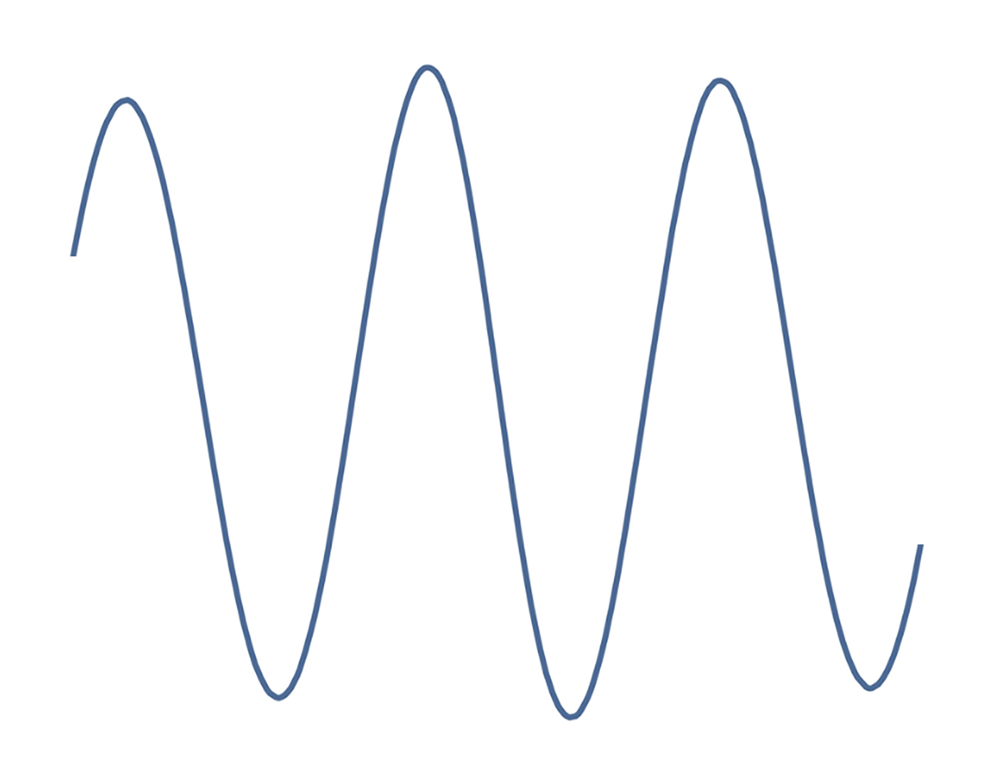



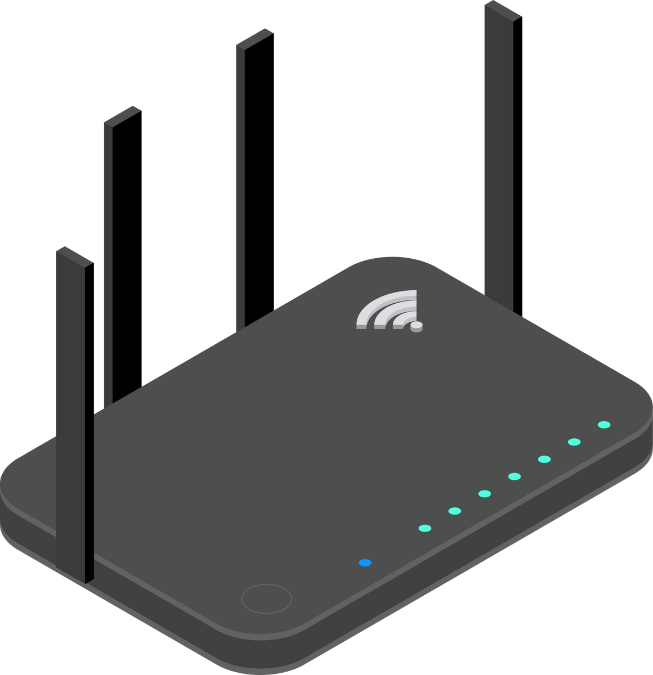




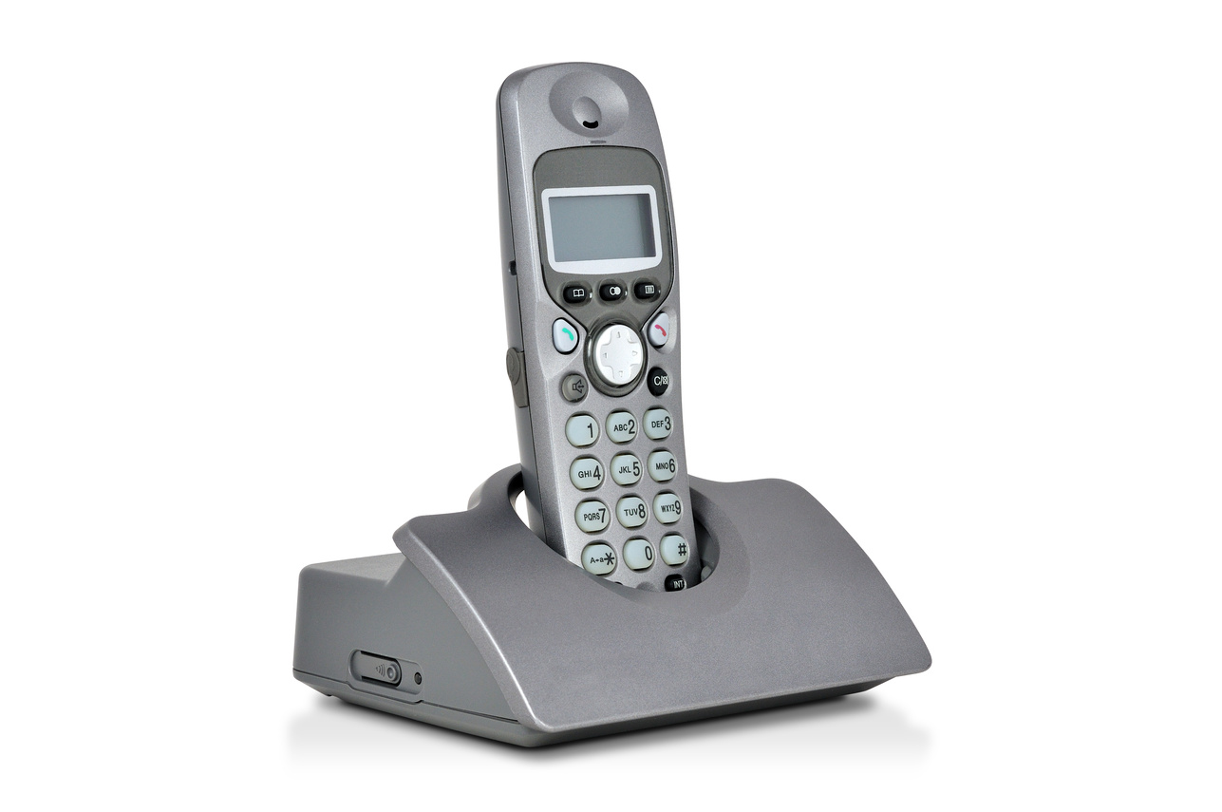
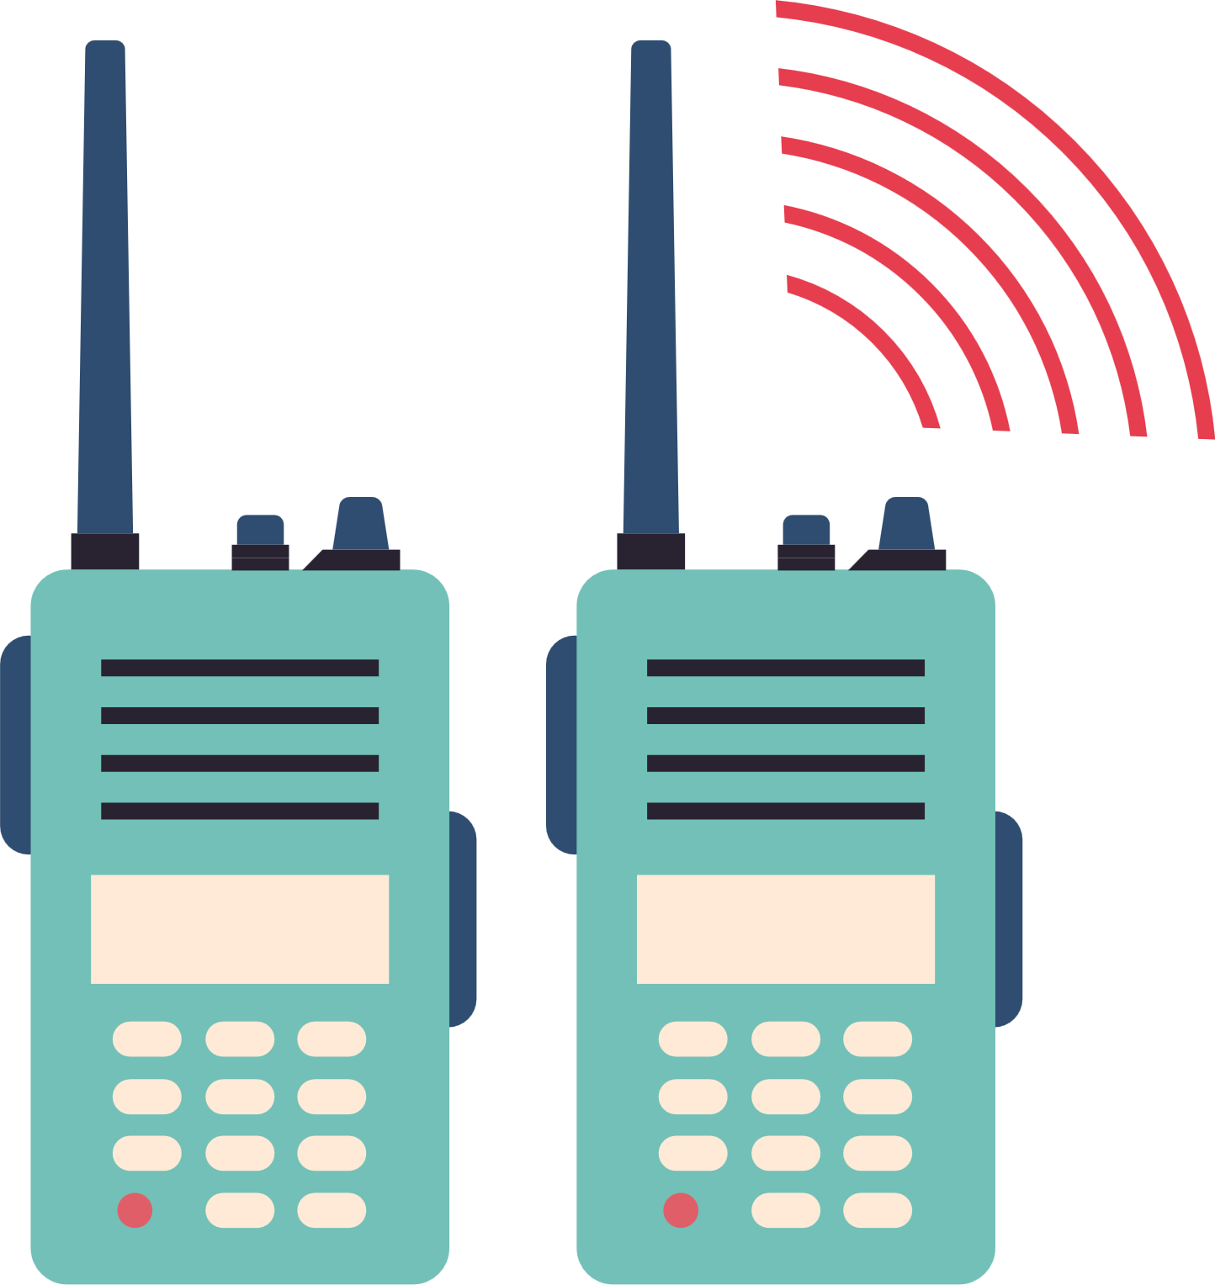
20 Years of WiFi Success Story
2022
5G Speeds FOR BILLIONS WITH Wi-Fi
2007
1994
BUSINESS ESSENTIAL
Wi-Fi 6 global annual chipset shipments will exceed 1 billion.
1985
1990
Wi-Fi GOES TO COLLEGE
1999
Laptops replace Desktops as the go-to work computer, making Wi-Fi a critical business technology
JUNK BANDS
WIRELESS PAYMENTS INTRODUCED
Carnegie Mellon University begins installing the first campus-wide Wi-Fi network.
LOOK MA,
NO WIRES!
2010
The FCC makes an unprecedented move, opening up three spectrum bands for unlicenced use anyone who follows the rules can use them . This spectrum was previously used for government radar.
2017
ABI Research, 2018
Steve Jobs unveils Apple’s iBook, the first commercial laptop able to surf web wirelessly.
TABLETS
NEW REALITIES
EVEN MORE Wi-Fi
WaveLAN, an early version of Wi-Fi, I installed in cash registers a critical first step for digital payments and the wireless economy
Wi-Fi-only tablets were introduced, setting off the global mobile computing revolution in homes, offices and businesses.
The first self-contained virtual reality headset launches, powered entirely by Wi-Fi.
57% of internet traffic will run over Wi-Fi,
Carnegie Mellon University, 2011
IHS Markit, 2008
Cisco, 2018
FCC, 2002
EE Times, 2015
Cult of Mac, 2016
Fast Company, 2010
Oculus, 2019
1985
1991
FROM TRASH TO LITTLE TREASURES
2015
2018
CUTTING THE CORD
2005
BILLION SOLD
MILLIONS SOLD
Wi-Fi $UPERCHARGES THE ECONOMY
This spectrum is almost immediately put to use for home appliances like microwaves, garage door openers and baby monitors
10 billion Wi-Fi devices have been sold , from cell phones to tablets to sensors at railyards and wirless airport gates operations to medical telemetry units and point of sale devices in retail stores, Wi-Fi powers our daily lives
Vtech releases the first 900 MHZ cordless phone using the former junk spectrum
1997
More than 120 million Wi-Fi chipsets shipped.
1988-1989
WIRELESS ROUTERS ARRIVE
A NEW STANDARD
2008
Wi-Fi generated more than $500 billion in economy value in the United States
2023
Wi-Fi Alliance, 2005
SMART PHONES
SPOILER: THIS
WILL BE BIG
The first wireless routers, the Proxim 900 MHz RangeLAN and ARLAN-SST. Were specialty devices to connect computers in warehouses and track retail inventories
Chicago Tribune, 1993
The first set of standards for Wi-Fi the IEEE 802.11 protocol is released. It carries data at 2MB/S
Apple’s iPhone 3G launches with Wi-Fi, kicking off the smartphone era and a boom in Wi-Fi devices and traffic.
FCC OET Working Paper, 2003
Wi-Fi is expected to generate nearly $1 trillion for the U.S economy in 2023
WifiForward, 2018
The Verge, 2019
Wi-FI Alliance, 2018
IEEE,2008
Apple, 2008
Wi-Fi Alliance, Jan 2015
Source: WiFi Forward

Slide 12
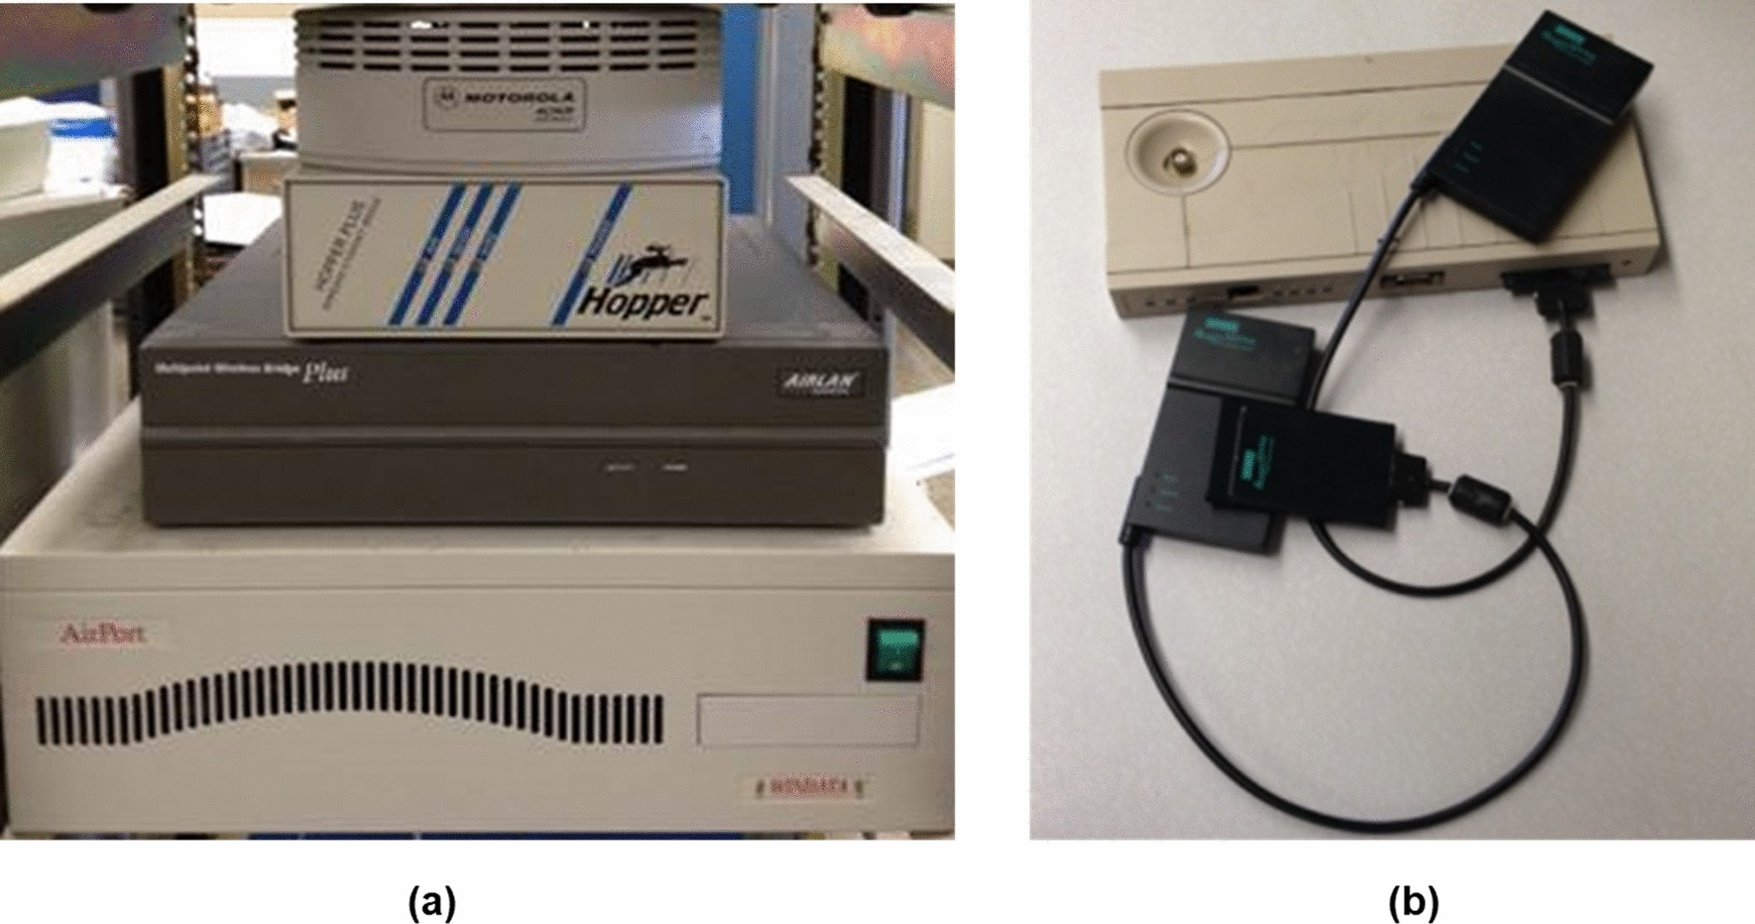
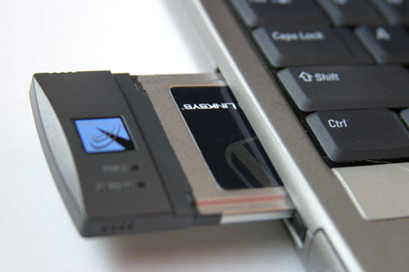
Some Initial WiFi Hardware
a Some historical pioneering shoe box size WLANS designed by Motorola, Persoft, Aironet, and WINDATA, b the wireless PC cards and its access points in Roamabout designed by Digital Equipment Corporation

Slide 13
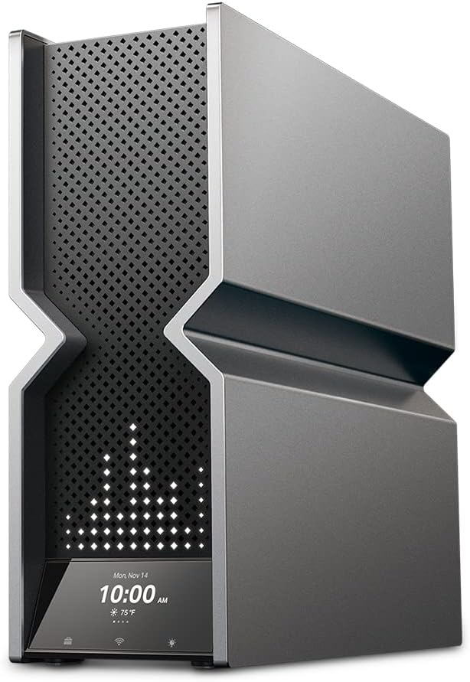
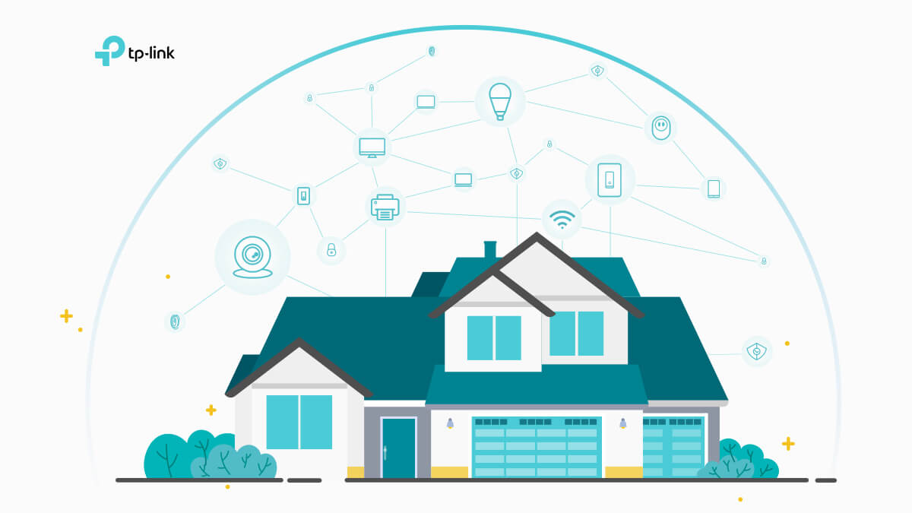
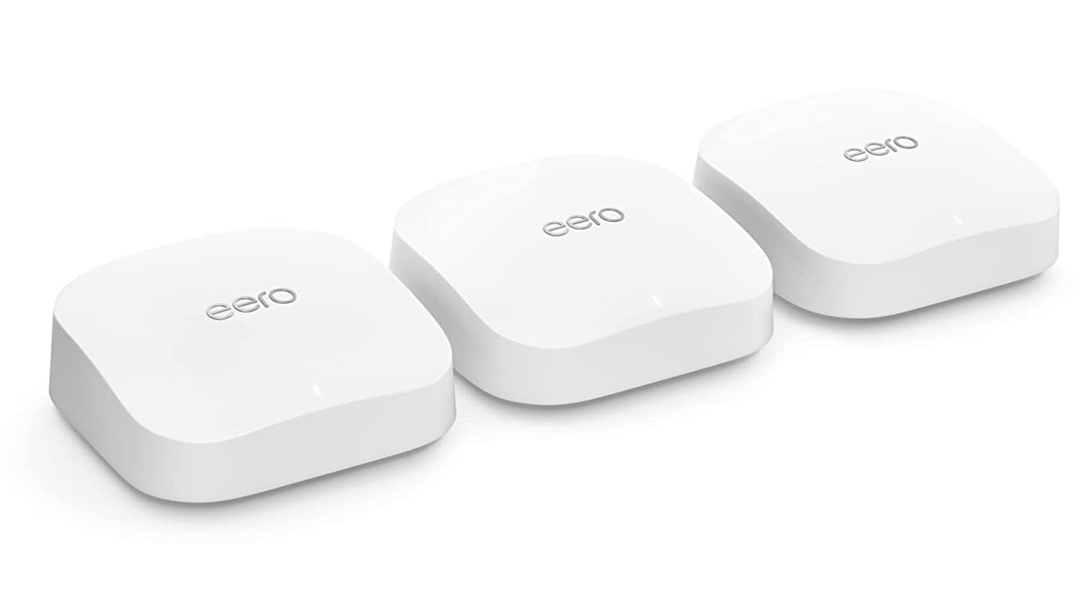
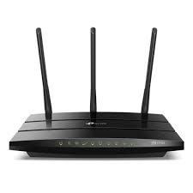
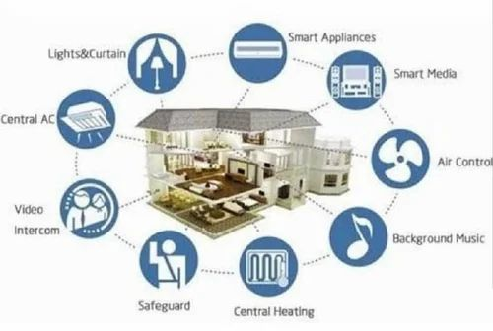
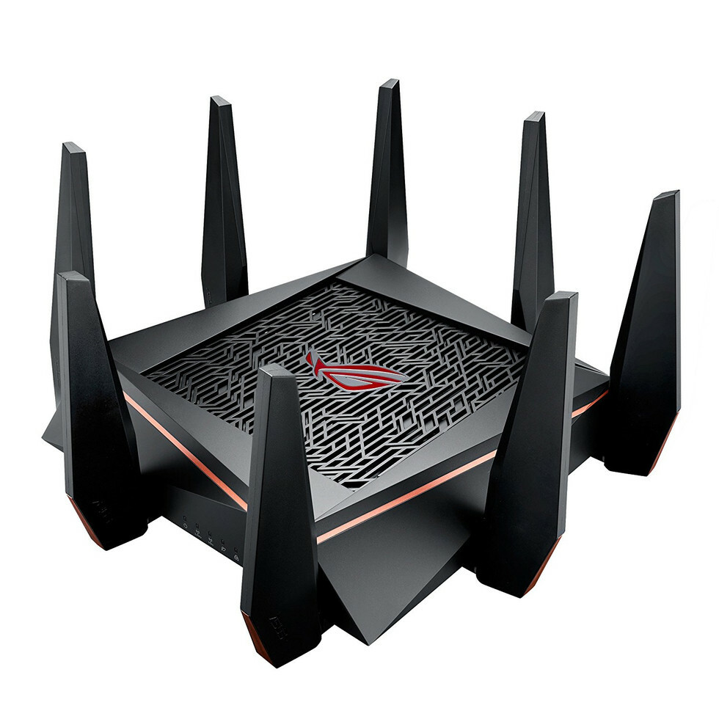
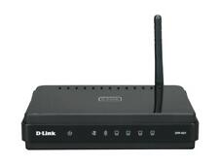

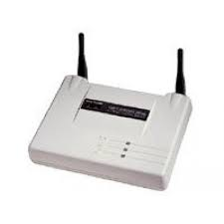
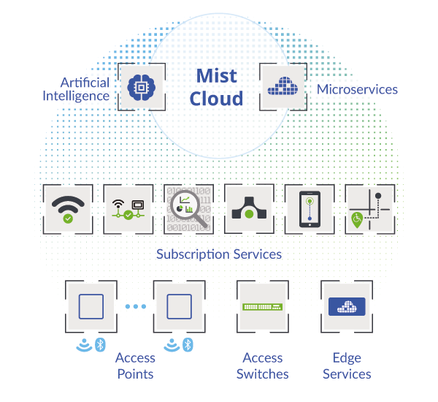
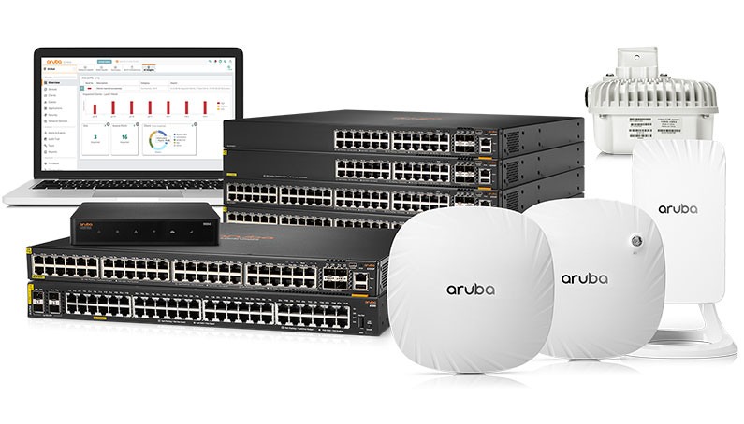
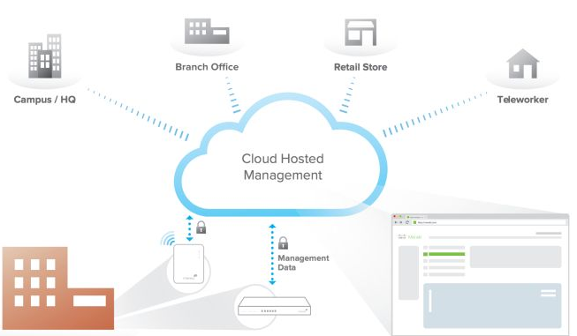

WiFi Technology Evolution (Hardware to Software)
10Gbps
Mesh, Increase Coverage
Parental Controls
OTT, Video Streaming
50Gbps
Connected Home/Home Automation
High Density
AR/VR
1Gbps
Operator Deployments
High Security
Voice, Video
11Mbps
DSL Backhaul
Low Security
Email, Text
Residential
1990s
2000s
2010s
2020s
Enterprise
11Mbps
Standalone AP
Low Security
Email, Text
1Gbps
Controller based APs
Large Scale Deployments
High Security
Web conferencing, VOIP
10Gbps
Cloud Managed APs
Centralized Control
Analytics and Business Intelligence
Video, Web Conferencing
50Gbps
AI/ML in WiFi
Network as a Service
AR/VR

Slide 14



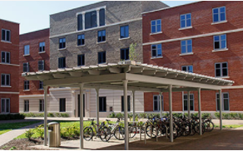




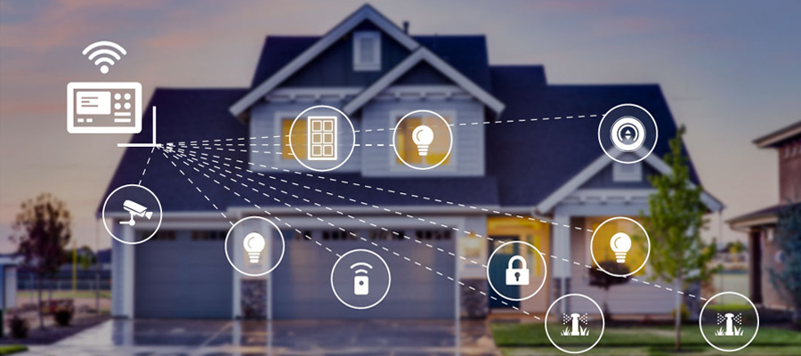
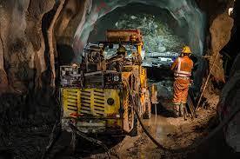
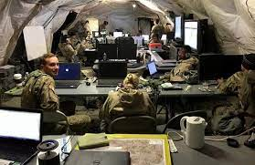

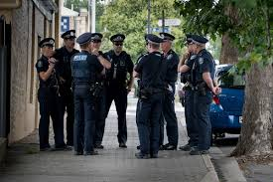
WiFi in Key Industries
Healthcare
Smart Cities
Hospitality
Public WiFi
Education
Apartments
Oil and Gas
Retail
Offices
Transportation
Agriculture
Smart Home
Mining
Defense
Manufacturing
Public Safety

Slide 15



WiFi Technology Life Cycle / Industry Ecosystem
Use Cases
Pre-Silicon Design Verification
Develop WiFi APs/Routers
Certifications
Deployment
PAR, Basic concepts submitted to Standards Bodies based on business case.
Verify designs through simulations, IDE tools.
Companies: Synopsis, Cadence, Mentor Graphics etc..
Develop and Test WiFi Routers/AP
Companies: Cisco, Aruba, Netgear, Asus, TPlink, Ubiquiti etc…
Various certifications for compliance
Companies: FCC, TUV, UL, WiFi Alliance
Operators, Service Providers, System Integrators
Companies: Airtel, Comcast, Telefonica etc..
Standards/ Pre-Standards
Develop WiFi Chipsets
Proof of Concept/Plug fests
Manufacturing
Post Deployment
Develop WiFi Chipset and SoCs
Companies: Qualcomm, Broadcom, Intel, Mediatek etc.
Initial trails and testing of Beta hardware and standard implementation
Companies: WiFi Alliance, WBA, BBF etc..
OEMs/ODMs that mass produce WiFi SoCs, Modules and Routers
Companies: Askey, Pegatron, VVDN, Arcadyan etc..
Network Management, troubleshooting
Companies: Tanaza, SolarWinds, 7Signal, Aprecomm etc..
IEEE and all Member Companies

Slide 16
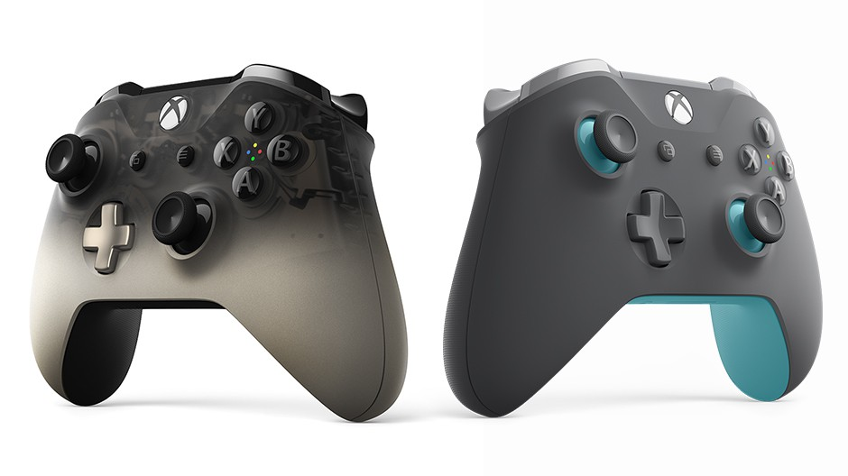
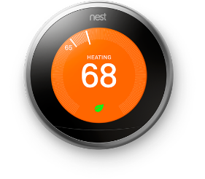

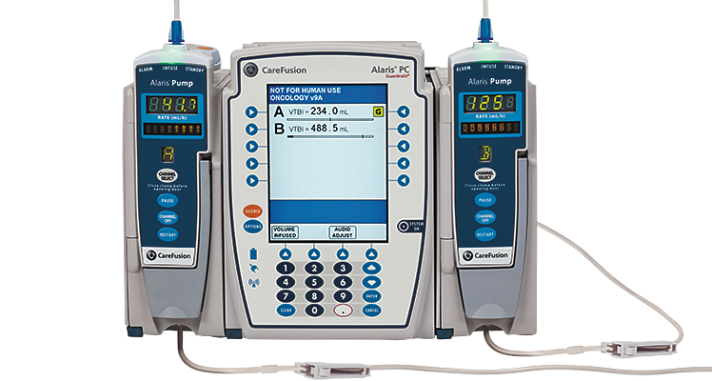
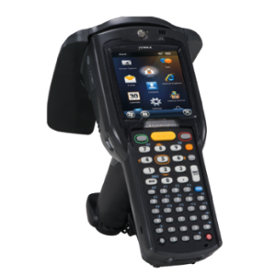

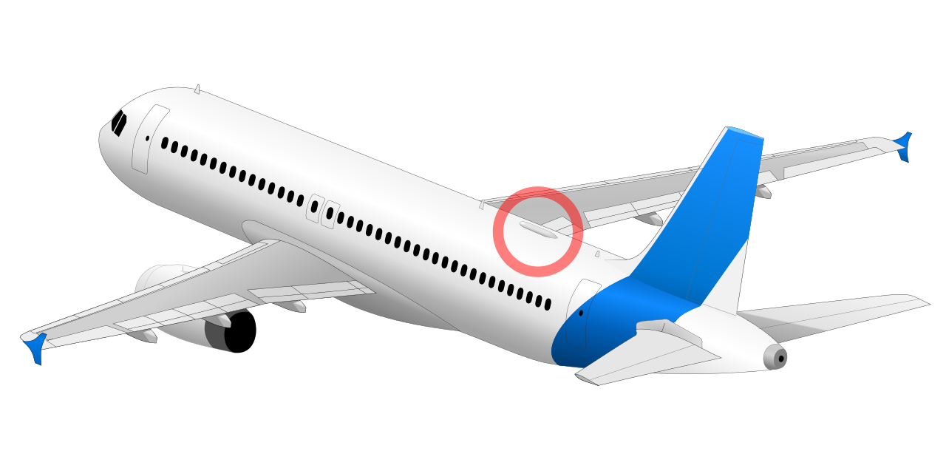
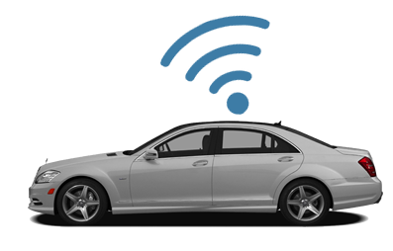
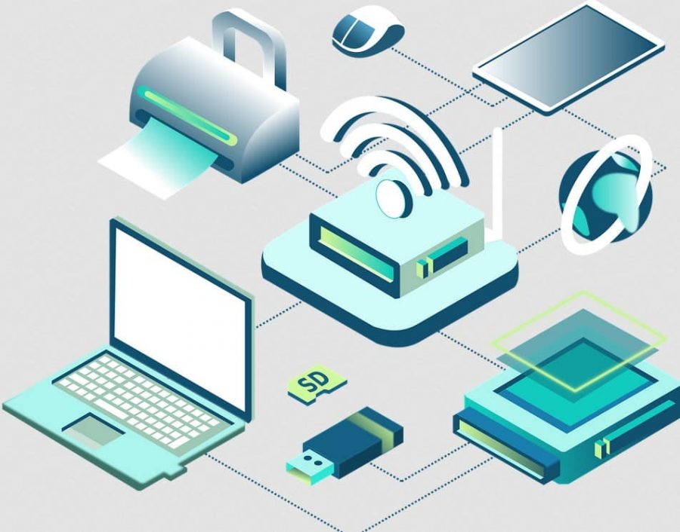
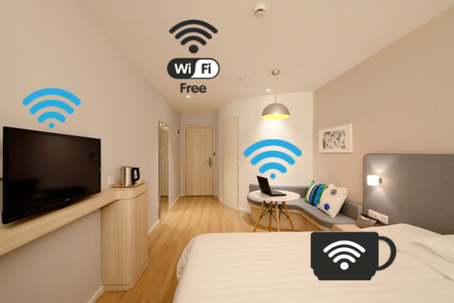
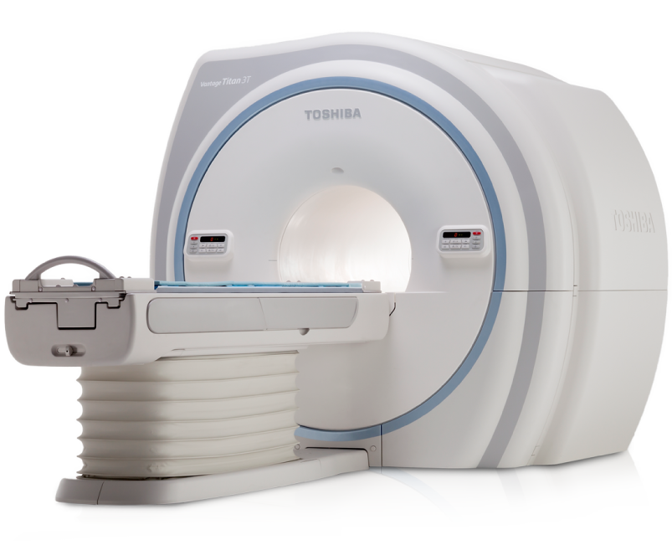
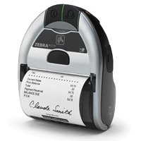
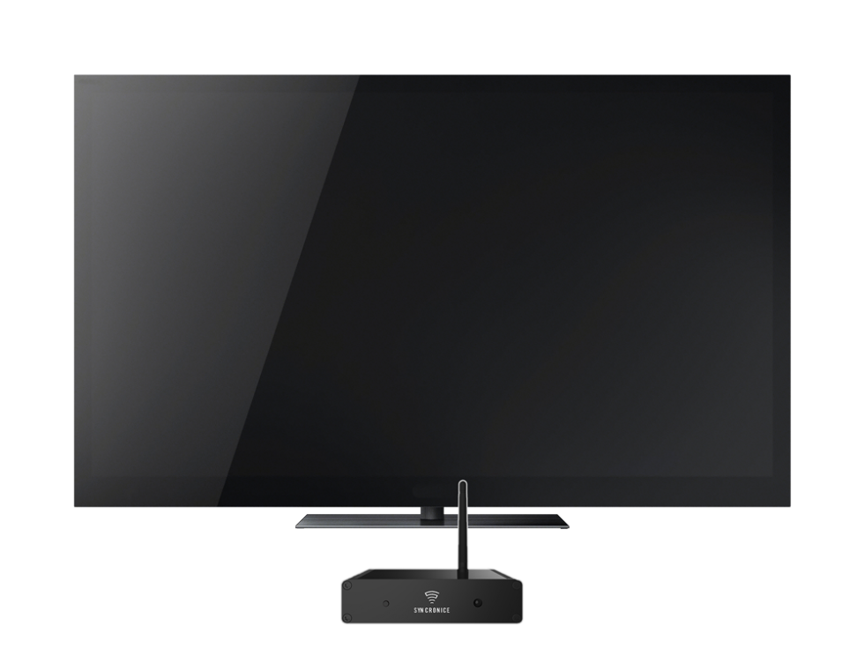
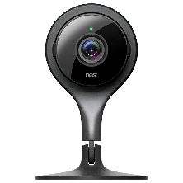
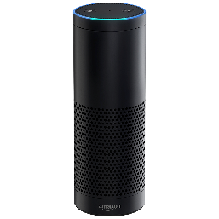
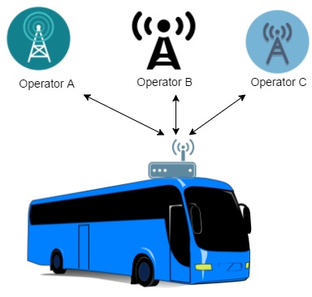
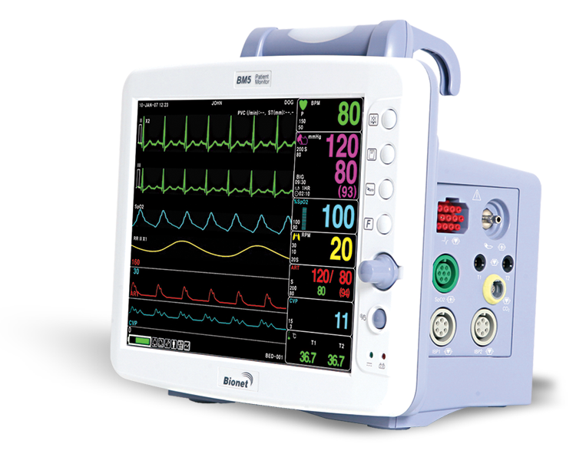
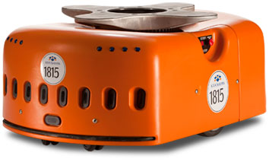

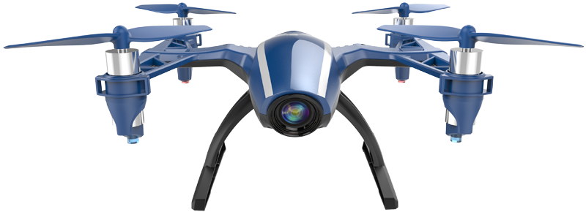
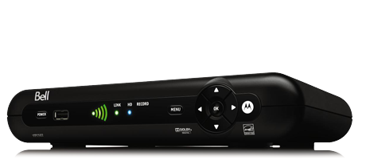



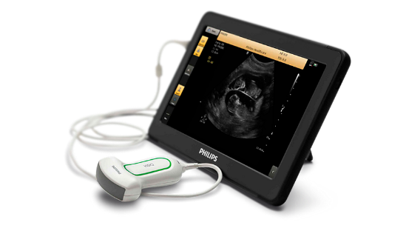


WiFi Devices
Home
Healthcare
Retail/Industrial
Transportation
Enterprise
Hospitality
Gaming Devices
Camera
Printer
Home Media Server
Set-top Box
Wireless TV
Refrigerator
Oven
Washer/Dryer
Vacuum Cleaner
Light bulbs
Security systems
Digital Photo Frames
Home Robot
Patient Monitor
Infusion Pump
Defibrillator
Weigh Machine
Asset Tracking
Blood Pressure Machine
Printer
Scanner
POS
Warehouse equipment
Shipping lines
Asset Tracking
Industrial Robots
Power Meters
Surveillance
Temp Pressure Monitoring Systems
Trains
Planes
Ships
Cars
Drones
Laptops
Smartphones
Tablets
Video conferencing Devices
Surveillance
Digital Whiteboards
Wireless TVs
Digital Tables
Rental Cars

Slide 17
WiFi Technology Generations
 | Wi-Fi 4 (IEEE 802.11n) | Wi-Fi 5 (IEEE 802.11ac) | Wi-Fi 6 (IEEE 802.11ax) | Wi-Fi 6E (IEEE 802.11ax) | Wi-Fi 7 (IEEE 802.11be)
Frequency bands operations | 2.4GHz (2.402 - 2.494) 5GHz (5.030 - 5.990) | 5GHz (5.030 - 5.990) | 2.4GHz (2.402 - 2.494) 5GHz (5.030 - 5.990) | 2.4GHz (2.402 - 2.494) 5GHz (5.030 - 5.990) 6GHz (5.925 7.125) | 2.4GHz (2.402 - 2.494) 5GHz (5.030 - 5.990) 6GHz (5.925 7.125)
Maximum bandwidth per channel | 2.4GHz: 40MHz 5GHz: 40MHz | 2.4GHz: 40MHz 5GHz: 80MHz | 2.4GHz: 40MHz 5GHz: 160MHz | 2.4GHz: 40MHz 5GHz: 160MHz 6GHz: 160MHz | 2.4GHz: 40MHz 5GHz: 160MHz 6GHz: 320MHz
Maximum number of non- overlapping channels | 2.4GHz: 3 Channel:1,6,11 | 5GHz: Channels:36,52 (80MHz) | 2.4GHz: 2 (40MHz) Channel:1,11 5GHz: Channel 36: 5.180 GHz to 5.340 GHz (160 MHz width) or Channel:36,52,100,116,132(80 MHz) | 2.4GHz: 2 (40MHz) Channel:1,5,9,13 5GHz: Channel 36: 5.180 GHz to 5.340 GHz (160 MHz width) Channel 36,52,100,116,132 (80MHz) 6GHz: 7 (160MHz) | 2.4GHz: Channel 1,5,9,13 (40MHz) 5GHz: 2 (160MHz) or Channel 36,149 (80MHz) 6GHz: Channel 31, 63, 95, 127, 159, 191 (320MHz)
Maximum MIMO configuration | 4x4 | 4x4 | 8x8 | 8x8 | 16x16
Highest modulation | 64 QAM | 256 QAM | 1024 QAM (1K QAM) | 1024 QAM (1K QAM) | 4096 QAM (4K QAM)
Maximum PHY datarate | 600 Mbps | 1.73 Gbps | 9.6 Gbps | 9.6 Gbps | 46.1 Gbps
Multi user MIMO (MU- MIMO) | N/A | Downlink (Wave 2 only) | Downlink Uplink | Downlink Uplink | Downlink Uplink
Multi user OFDMA (bandwidth sharing) | N/A | N/A | Yes | Yes | Yes
Target Wake Time (TWT) | N/A | N/A | Yes | Yes | Yes (improved)
Multi Link Operation / Multi Resource Unit | N/A | N/A | N/A | N/A | Yes

Slide 18
Why WiFi Technology is so successful?
Low Cost
Enterprise Grade Security
Extremely low cost of installation (CAPEX) and maintenance (OPEX) when compared to cellular
Full enterprise grade security, seamless mobility, excellent user/policy/network management.
IP Network Compatible
Easy to Deploy
A seamless network edge extension of the ubiquitous IP networking.
No heavy equipment of infrastructure needed. Easy to install both indoor and outdoor when compared to cellular
Uses Unlicensed Spectrum
Scalability
Use of Unlicensed spectrum significantly decrease barriers for entry.
Can scale to 1000s of Access Points and lots of users and can be managed from single dashboard
High Data Rates
Open Technology
Extremely high dates for short/medium range fixed wireless when compared to all other technologies
WLAN standards are designed to be open , giving implementors a lot of flexibility to customize for applications.

Slide 19
Some References
Evolution and Impact of Wi-Fi Technology and Applications: A Historical Perspective
https://link.springer.com/article/10.1007/s10776-020-00501-8
The Evolution of Wi-Fi networks: from IEEE 802.11 to Wi-Fi 6E
https://www.wevolver.com/article/the-evolution-of-wi-fi-networks-from-ieee-80211-to-wi-fi-6e
The Evolution of Wi-Fi Technology and Standards
https://standards.ieee.org/beyond-standards/the-evolution-of-wi-fi-technology-and-standards/
Beyond Everywhere : How Wi-Fi became the world’s most beloved technology
https://www.gregennis.net/
The Wi-Fi Evolution An integral part of the wireless landscape
https://www.qualcomm.com/content/dam/qcomm-martech/dm-assets/documents/Web_WiFi_Evolution_Tech_Exe_04022013.pdf
Steve Jobs introduces WiFi to the masses with a hula hoop!
https://www.youtube.com/watch?v=HFngngjy4fk

Slide 20


